Slide 1
Texas Consumer Resource for Education and Workforce Statistics
Ruben B. Garcia
Texas Workforce Commission

Slide 2
Objectives
Brief history of consumer reports in Texas
Impetus in building TX CREWS
Demonstration of TX CREWS
Show new ISD-level reports on Texas P-16 Public Education Information Resource (TPEIR)

Slide 3
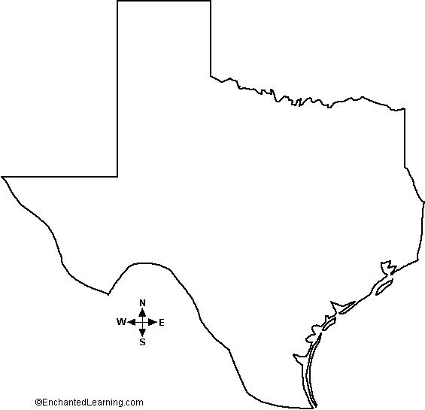
Consumer
Report
System

Slide 4
DECIDE
CD version May 1998
Live online July 1, 1999
1999 US Dept. of Labor Jett-Con Award
Texas 1st in the nation to have a consumer report
Connecticut
Maryland
Massachusetts
Wisconsin
Iowa

Slide 5
TX CREWS
Funded by the US Dept. of Labor through the Workforce Data Quality Initiative
HB 1296 (Alvarado) -- compare each institution of higher education with other institutions regarding:
(A) the relative cost of tuition;
(B) the retention rate of students;
(C) the graduation rate of students;
(D) the average student debt;
(E) the loan repayment rate of students; and
(F) the employment rate of students;

Slide 6
http://www.thecb.state.tx.us/apps/txcrews/

Slide 12
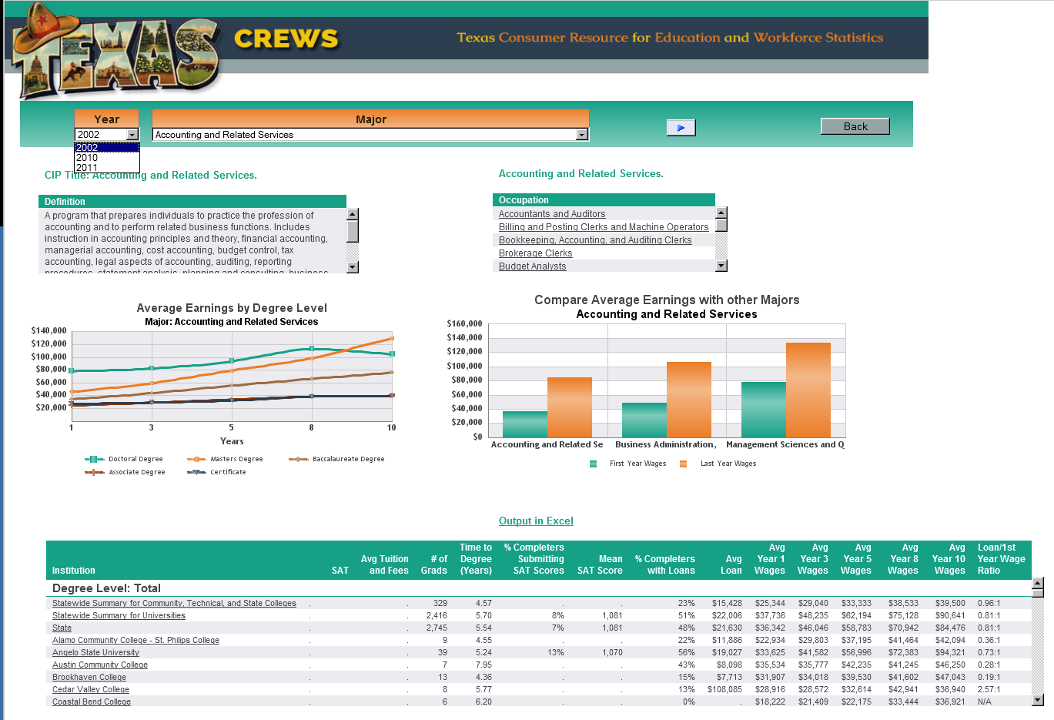

Slide 18
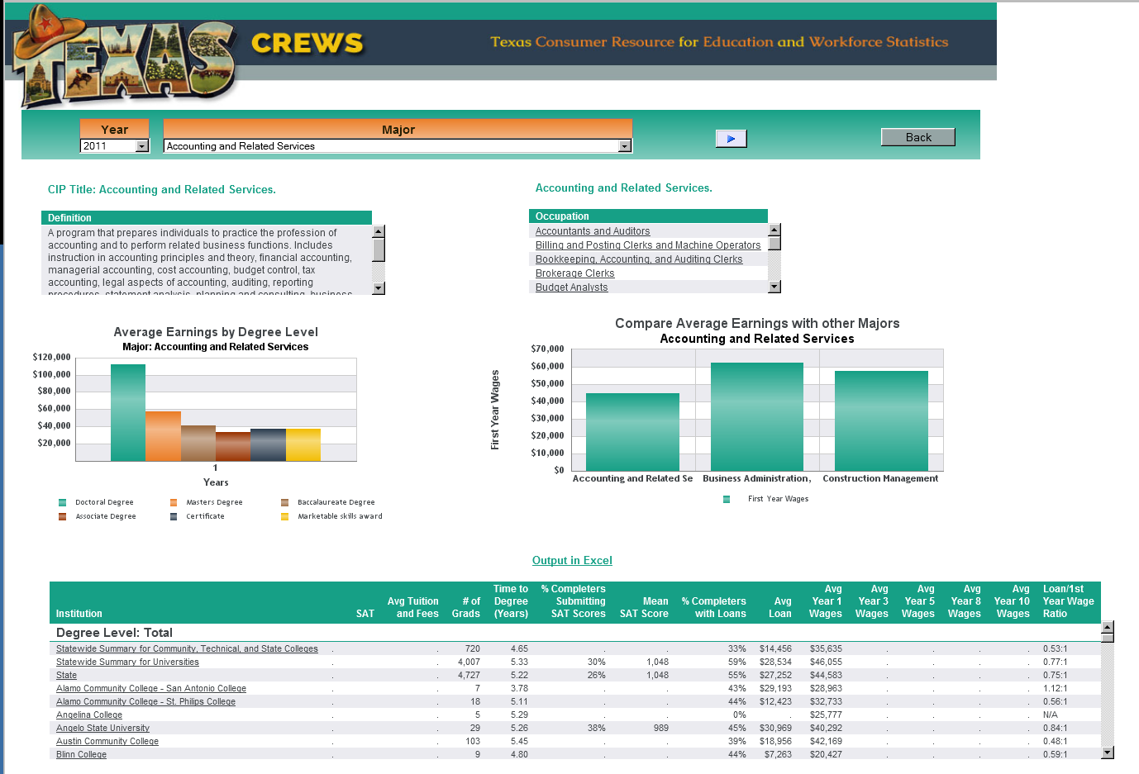

Slide 20
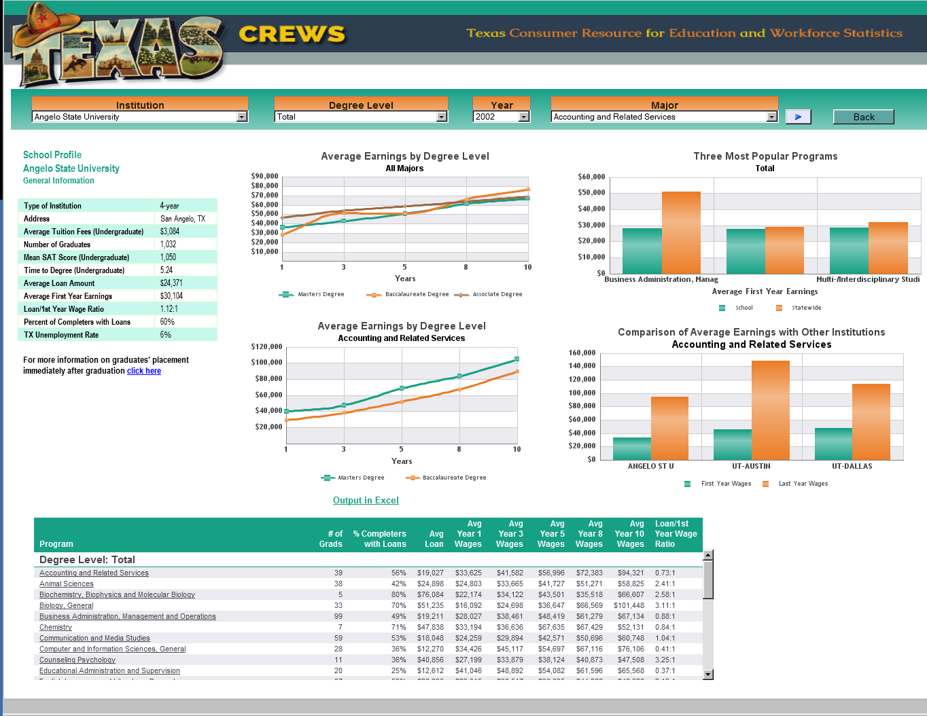

Slide 21
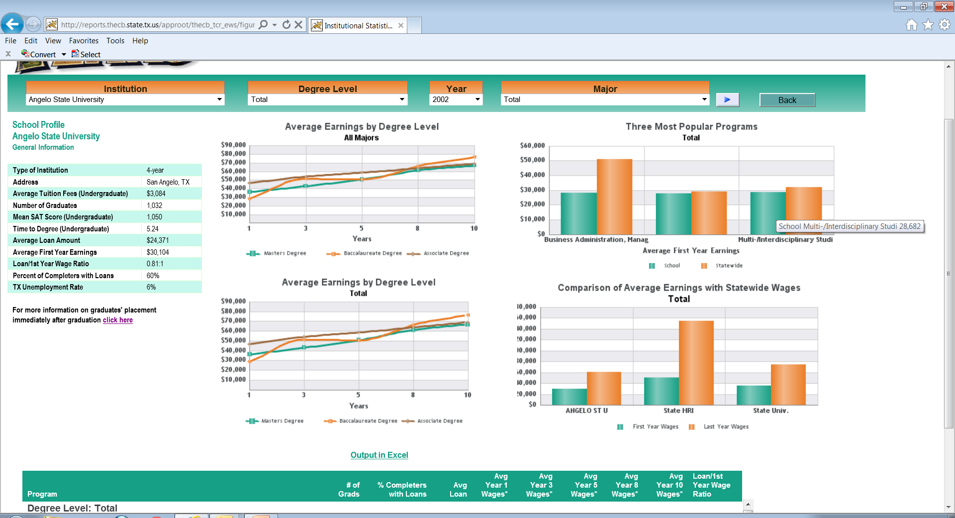

Slide 26
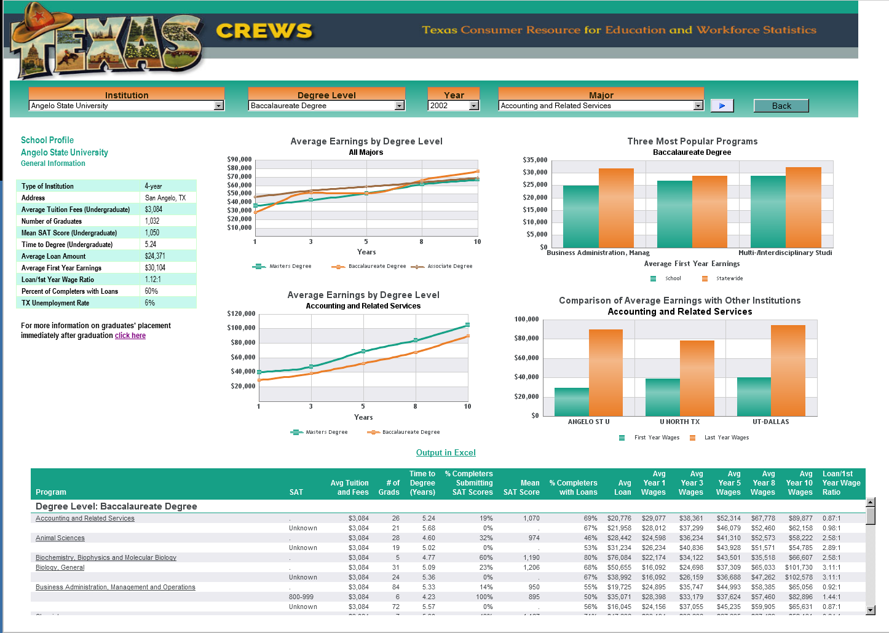

Slide 27
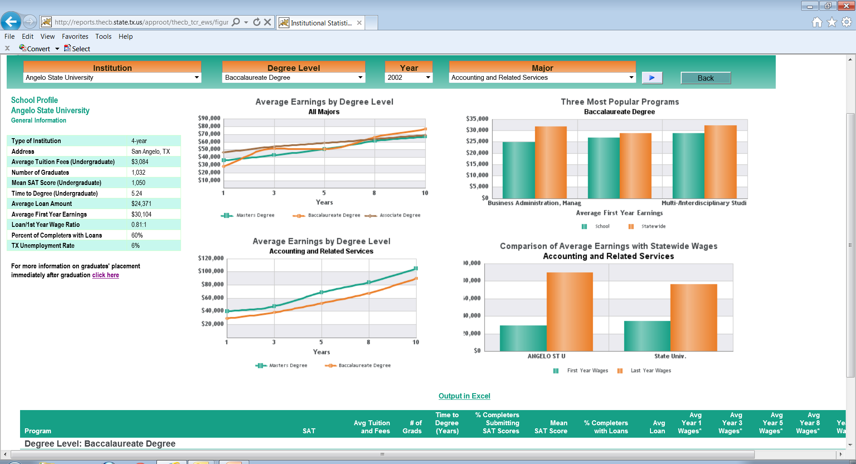

Slide 28
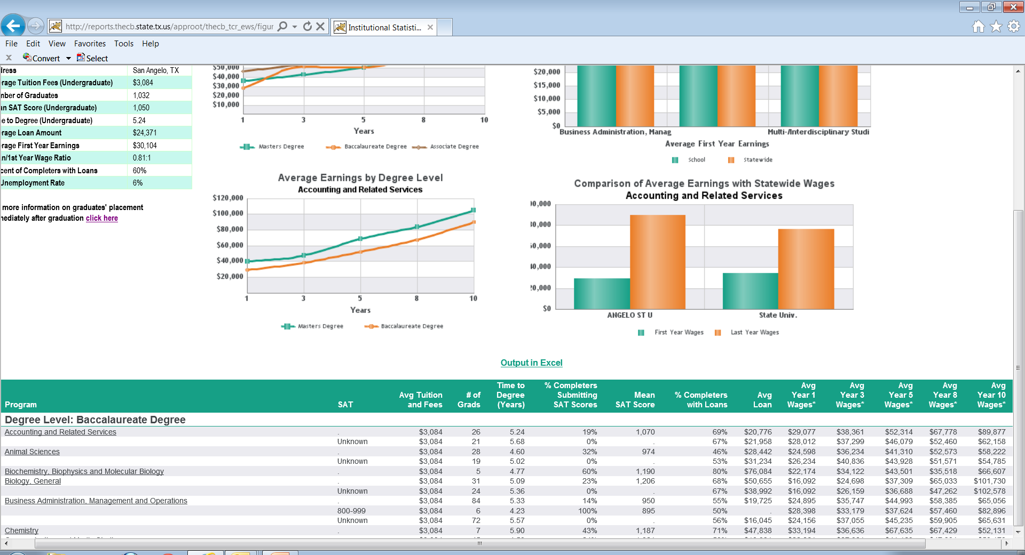

Slide 31
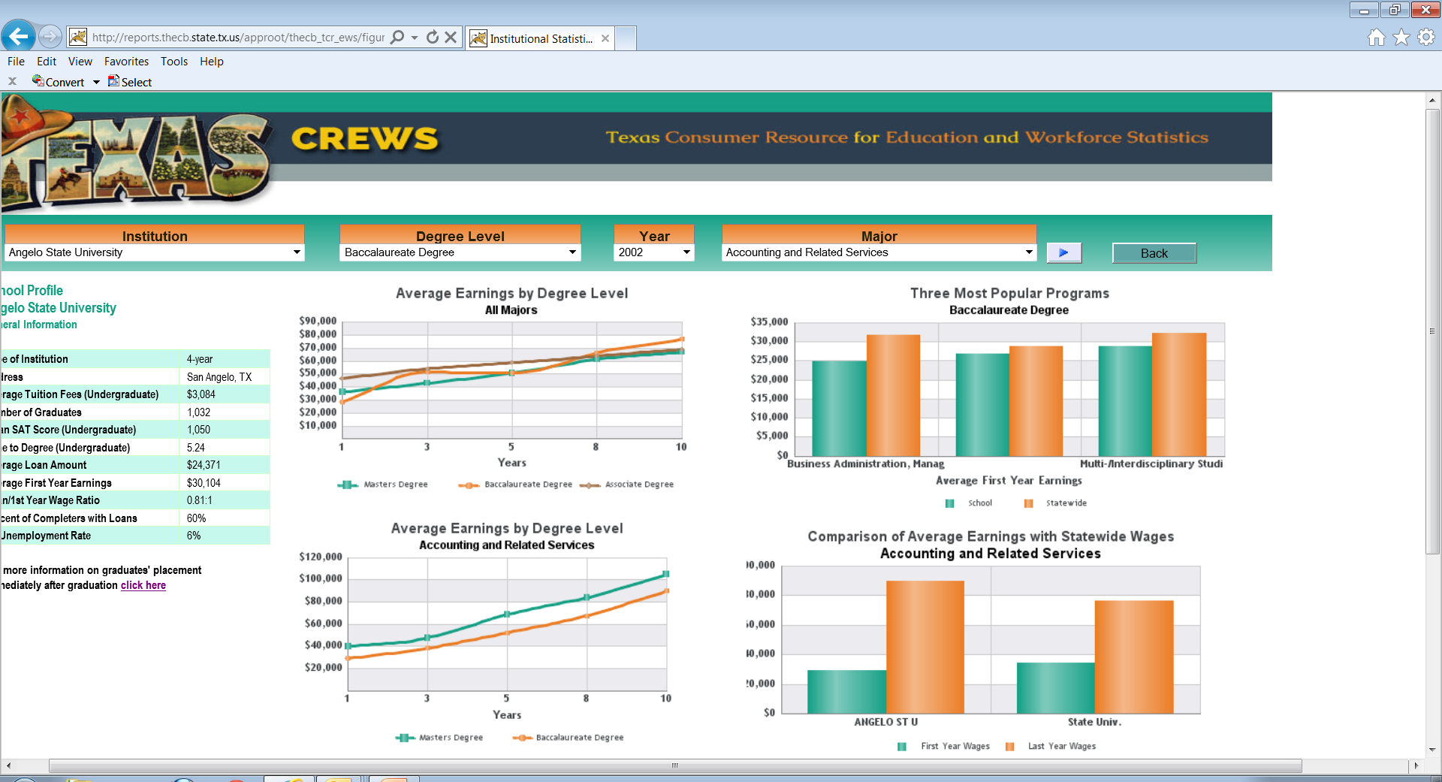

Slide 34
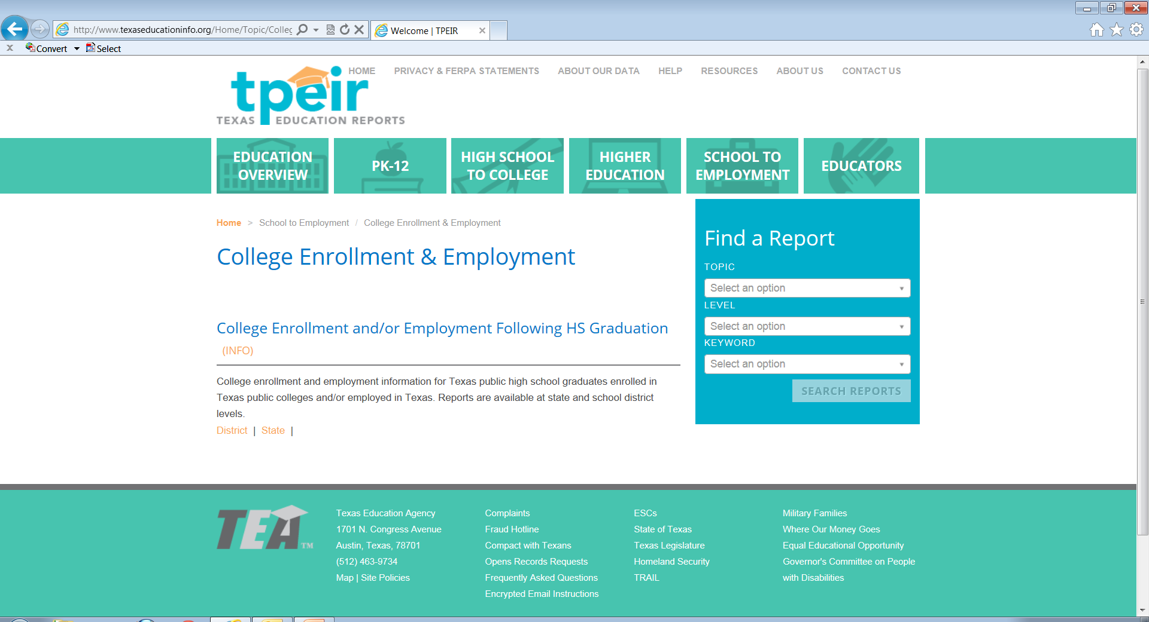

Slide 35
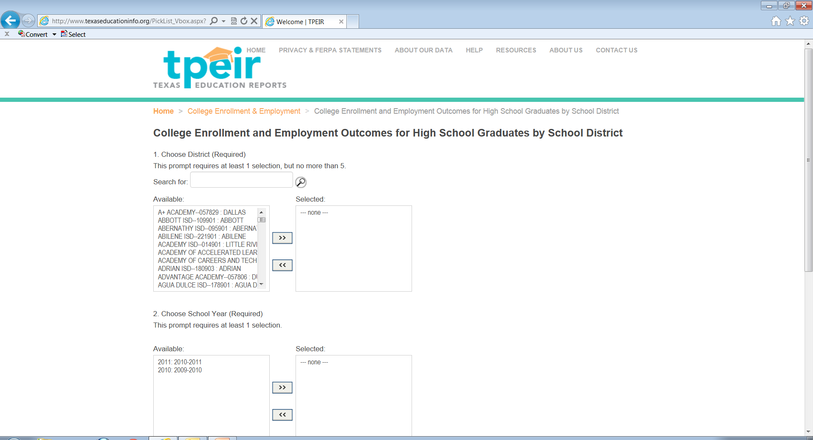

Slide 36
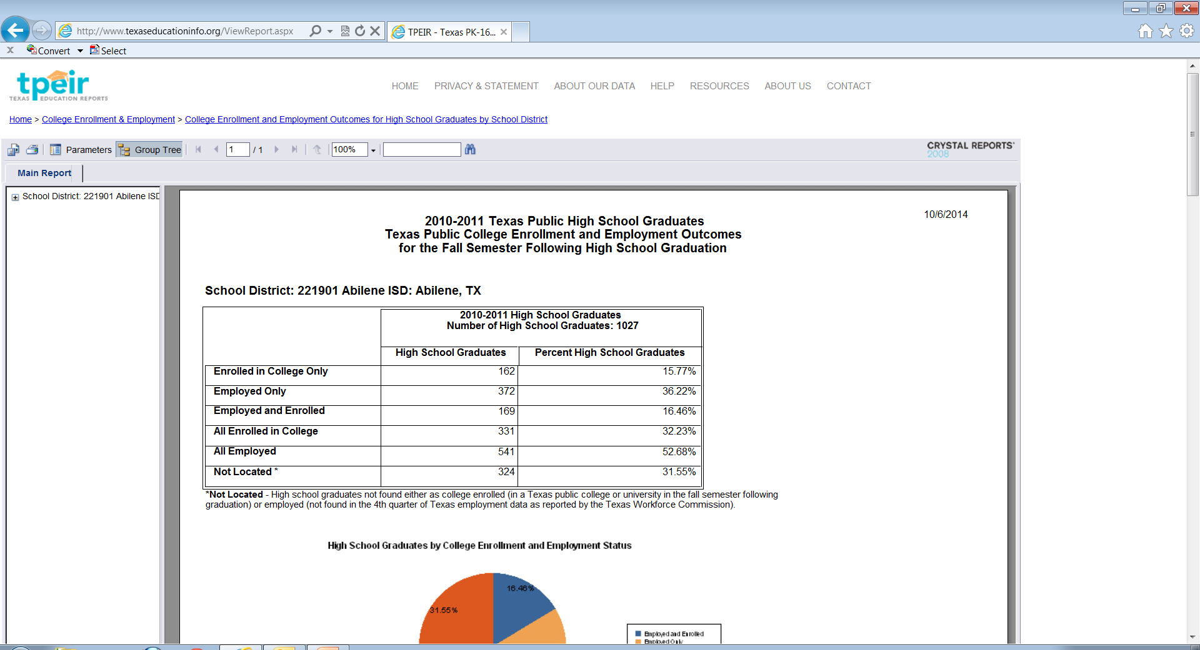

Slide 37
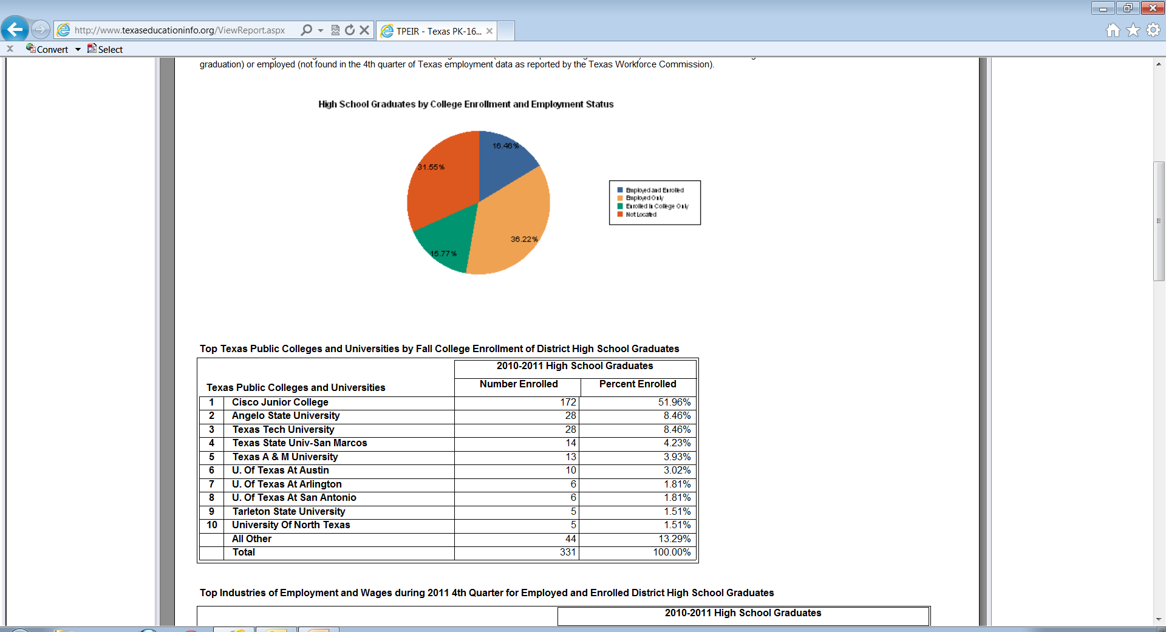

Slide 38
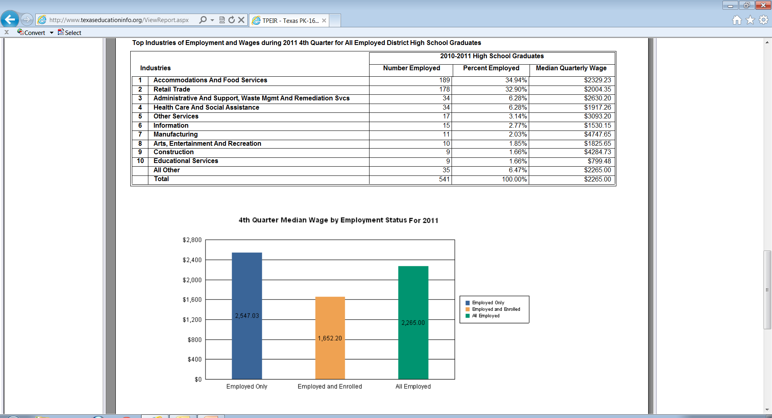

Slide 39
QUESTIONS?
Ruben B. Garcia
Ruben.garcia@twc.state.tx.us
(512) 936-3112

